Slide 1

Analysis of House Sales in a Northwestern County
Penina Wanyama
November 14,2022

Slide 2
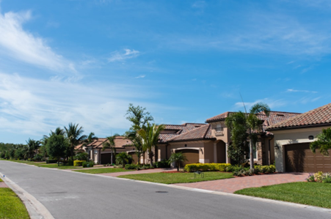
Summary
Regression analysis of the house features on the existing King County Housing Authority data predicts that the house unit prices could increase if:
Older houses are renovated to include features such as water fronts, increased number of bathrooms
The grade and overall condition of houses are improved
House owners can build houses that have at least one floor up

Slide 3
outline
Business Problem
Data &Methods
Modeling/Model evaluation
Conclusion/Recommendations

Slide 4
Business Problem
Identify the Most preferred features of houses in King County in terms of increased sales
Identify Worst performing features in terms of decreased sales
Create house sales improvement strategy

Slide 5
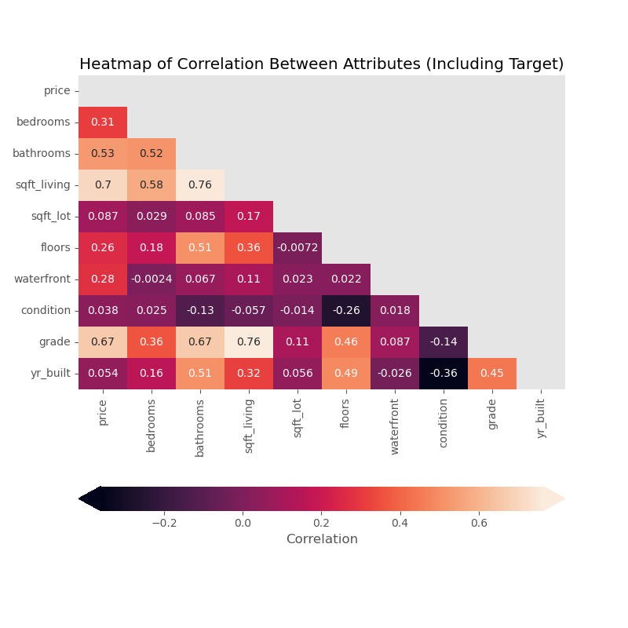
Data and Methods
Price correlation with various house features
House square ft living is the most positively correlated with a value of 0.7 then followed by the square followed by real estate house grading area with about 0.67

Slide 6
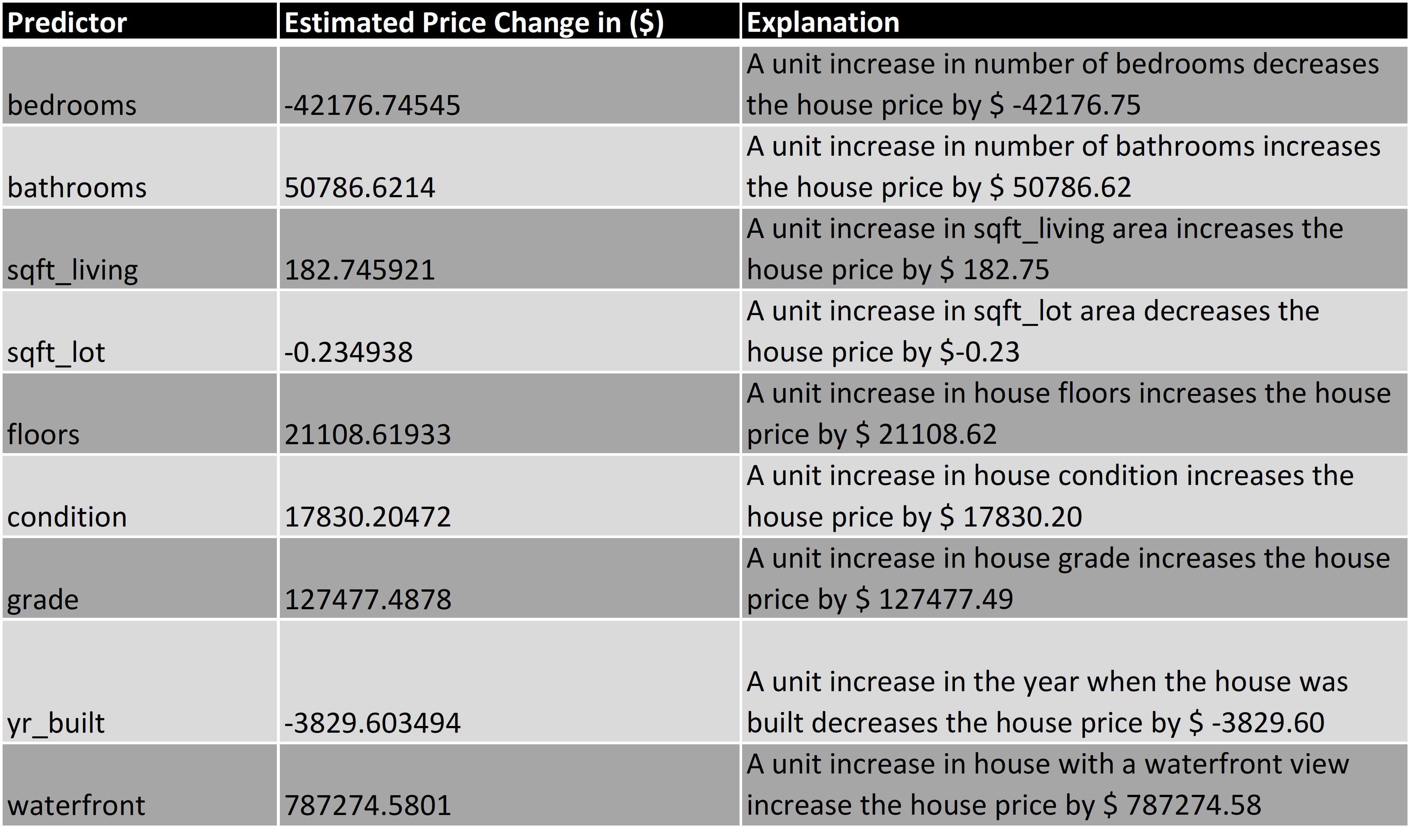
Regression Analysis Results- Interpretation
From our regression analysis the base price for a house is $ 6672793.67 with a standard deviation of about $216596.78. The price of a house unit however fluctuates with change in below factors as explained in the table

Slide 7
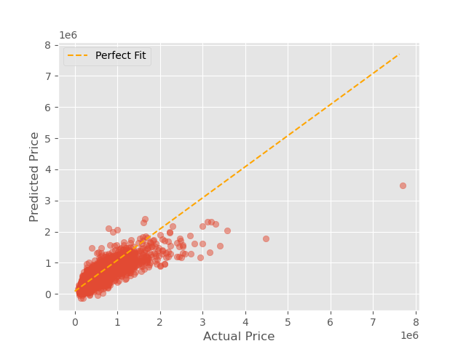
Model performance credibility
The model has a close to perfect linear relationship between our predicted house prices and the actual prices

Slide 8
Conclusions
The variables that will affect the price change of each house unit in Northwestern county are the number of bedrooms, number of bathrooms, square ft living area, number of floors, waterfront, overall house condition, the overall grade of the house, and the year the house was built with a standard deviation RMSE(Root Mean Squared Error) value of $ 216596.78.
From the final model interpretation, we see that Older houses and number of bedrooms have a negative change in price. While number of number of bathrooms, square ft living area, number of floors, waterfront, overall house condition, and the overall grade of the house have a positive impact on the price.

Slide 9
Recommendations
Older houses can be renovated to include features such as waterfront because each house unit that has a waterfront equals to a price increase of $ 787274.58.
Homeowners should build more houses that have more than one floor since the value price increment for each house is quite high -approximately $ 127477.49
The unit area change of the living room also affects the price by 182.74. Homeowners should build houses that have larder living areas in order to increase the house price.
The overall condition change of the house constitutes $ 17830.20 price increase. Homeowners should look for means to improve the overall condition of the house by perhaps repairing bathrooms or even increasing the number of the bathrooms in the house
Homeowners should also seek to change the real estate grading of their houses if possible since an upward change in the grade of the house increases the house price by $ 127477.48

Slide 10


Thank You!
Email: penina.wanyama@student.moringaschool.com
GitHub: @penina26

